Slide 1
Chapter 2 Digital Image Fundamentals

Slide 2
2.6 Mathematical Tools Used in Digital Image Processing
2.6.1 Array/Matrix
2.6.2 Linear/Nonlinear Operation
Exercise:
Give two examples of linear operations & two examples of nonlinear operations. (input is 1-D signal f(x))

Slide 3
2.6.3 Arithmetic Operation
s(x,y) = f(x,y)+h(x,y)
d(x,y) = f(x,y)-h(x,y)
p(x,y) = f(x,y) × h(x,y)
v(x,y) = f(x,y) ÷h(x,y)

Slide 4
Application of Arithmetic Operation
Addition
g(x,y) = f(x,y) + n(x,y)
n(x,y) is noise image. (2013/10/08)
Emulate Noise Effect
[Programming： Rand(), Saturation Operation]

Slide 5

Application of Arithmetic Operation

Slide 6
Averaging K different noisy images

Slide 7
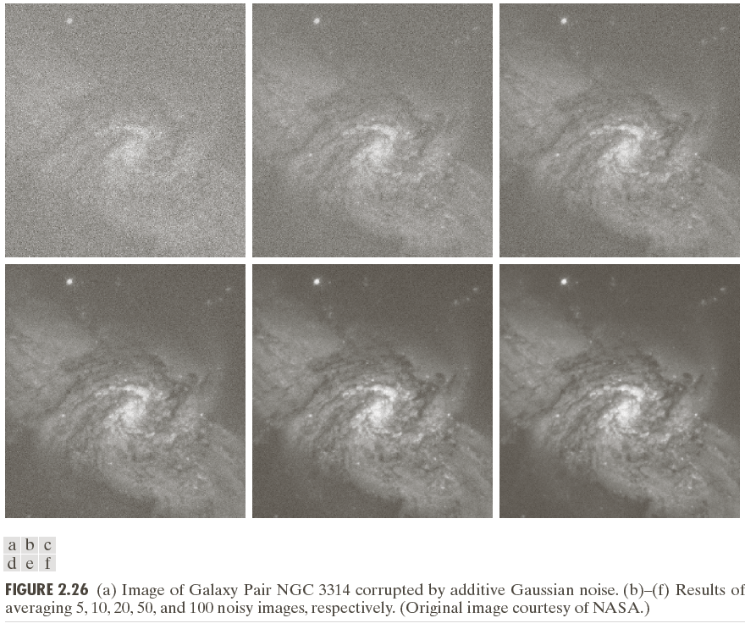

Slide 8
Subtraction
d(x,y) = f(x,y)-h(x,y)
Enhance the difference between 2 images

Slide 9
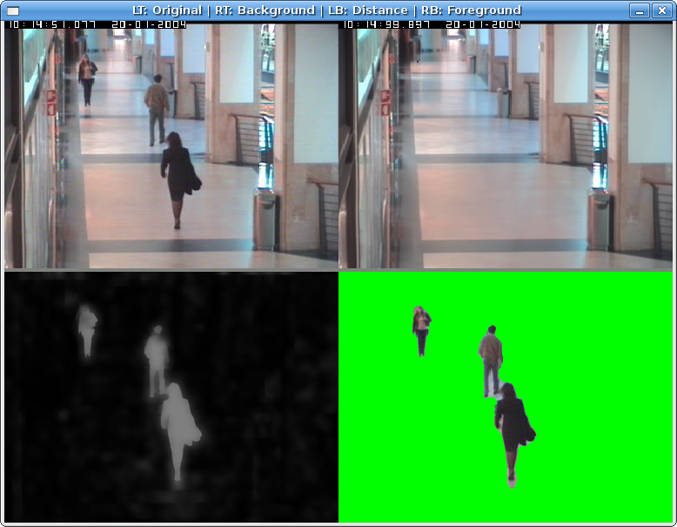
Application of image subtraction 1

Slide 10
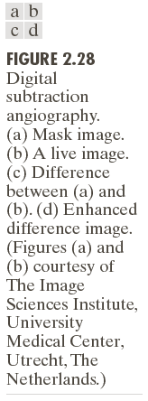
Application of image subtraction 2

Slide 11
Multiplication
g(x,y) = f(x,y) h(x,y)
f(x,y) = i(x,y) r(x,y) ,Image Formation Model, i(x,y): illumination components, 0<i(x,y)<∞,r(x,y): reflectance components, 0<r(x,y)<1
Emulate lighting effect.
g(x,y) = f(x,y) l(x,y)

Slide 12
Division
Shading Correction
f(x,y) = g(x,y) / l(x,y);
or Multiplication
f(x,y) = g(x,y) * (1/f(x,y))

Slide 13
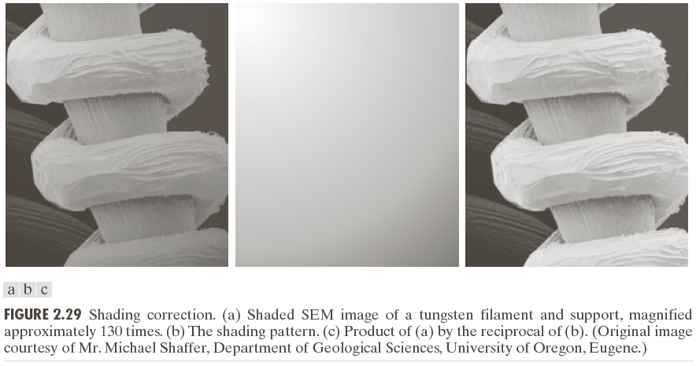
Application of image multiplication or division

Slide 14
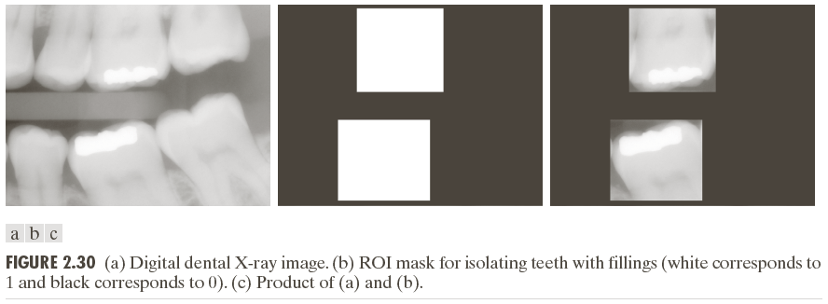
Application of Image Multiplication ROI ( region of interest ) operation

Slide 15
Other Application of Arithmetic Operation
How to display a image f(x,y) which value range is out of [0..255]
fm = f-min(f);
fs = K(fm/max(fm)), where K = 255

Slide 16
Mix Operation
g(x,y) = f1(x,y)*(1-u)+f2(x,y)*u

Slide 17
2.6.4 Set And Logic Operation (1) Set Operation

Slide 18
2.6.4 Set And Logic Operation (2) Logic Operation

Slide 19
Set Operation / Logic Operation

Slide 20
2.6.5 Spatial Operation
(1) Single pixel operation: g(x,y) = T(f(x,y))
g[x,y] = L-1-f[x,y]; L is gray levels (256)

Slide 21
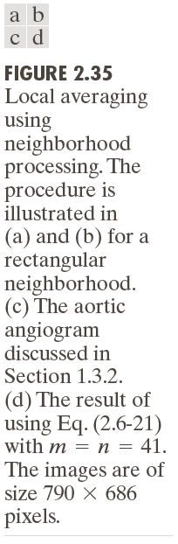
2.6.5 Spatial Operation
(2) Neighborhood operation

Slide 22
Neighborhood operation
Local averaging using 8-neighbors
g[x,y] = (f[x,y]+f[x-1,y]+f[x+1,y]+f[x,y-1]+f[x,y+1]+f[x-1,y-1]+f[x+1,y-1]+f[x-1,y+1]+f[x+1,y+1])/9

Slide 23
Exercise
A: g[x,y] = f[x,y]-f[x-1,y];
B: g[x,y] = f[x,y]+10;

Slide 24
2.6.5 Spatial Operation
(3) Geometric Image Transform
Spatial Transform

Slide 25
2.6.6 Vector and Matrix Operations

Slide 26
2.6.7 Image Transform
Forward Transform
Inverse Transform

Slide 27
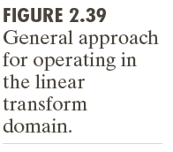
2.6.7 Image Transform

Slide 28
2.6.7 Image Transform

